Slide 1


Social Buzz Content Analysis

Slide 2


Today's agenda
Project recap
Problem
The Analytics team
Process
Insights
Summary

Slide 3

Social Buzz is a fast-growing technology unicorn that need to adapt quickly to its global scale. Accenture has begun a 3-month POC focusing on these tasks:
Conducting an audit of Social Buzz's big data practice.
Providing recommendations for a successful initial public offering. (IPO)
Analyzing Social Buzz's data to identify its top five most popular categories of content.
Project Recap

Slide 4


Problem
Social Buzz has reached over 500 million active users each month.
On average, over 100,000 pieces of content are posted to the platform each day, including text, images, videos, and GIFs.
All this data is highly unstructured, which can make it difficult to monetize.
To capitalize on the wealth of data generated by Social Buzz's massive user base, we need to find ways to make sense of it.

Slide 5



Andrew Fleming
Chief Technical Architect
The
Analytics
Team
Marcus Rompton
Senior Architect
Andrew Fleming
Data Analyst

Slide 6
Process
1
Data Cleaning
2
Data Wrangling
3
Merging of Data and Grouping
4
Data Visualization
5
Data Analysis and Conclusion

Slide 7
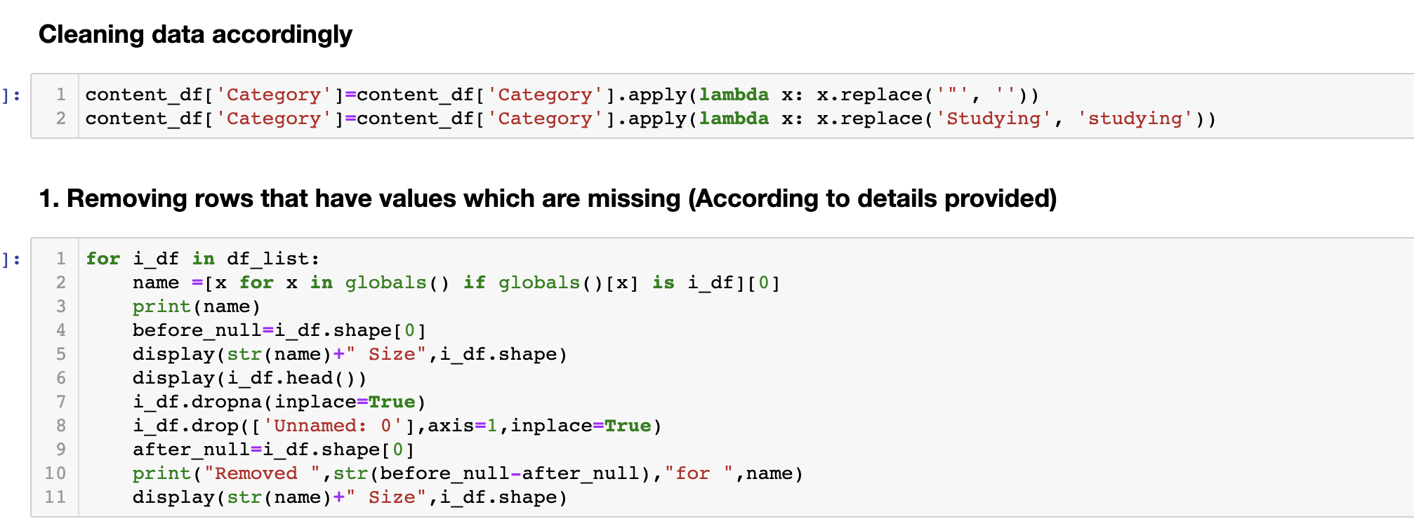
Data Cleaning
Cleaning Data accordingly like removing quotes.
Converting Studying to studying a single format.
Removing columns like UserID, URL from all the
relevant datasets

Slide 8
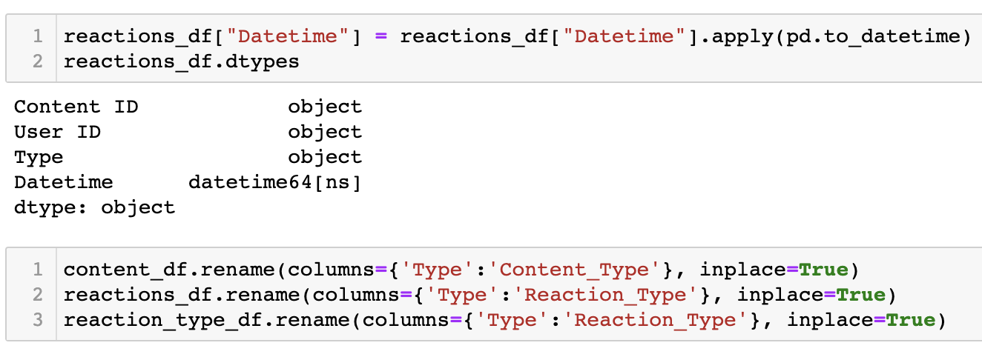
Data Wrangling
Converting Datetime to the correct format.
Renaming Columns so as to while merging there
are not conflicts.

Slide 9
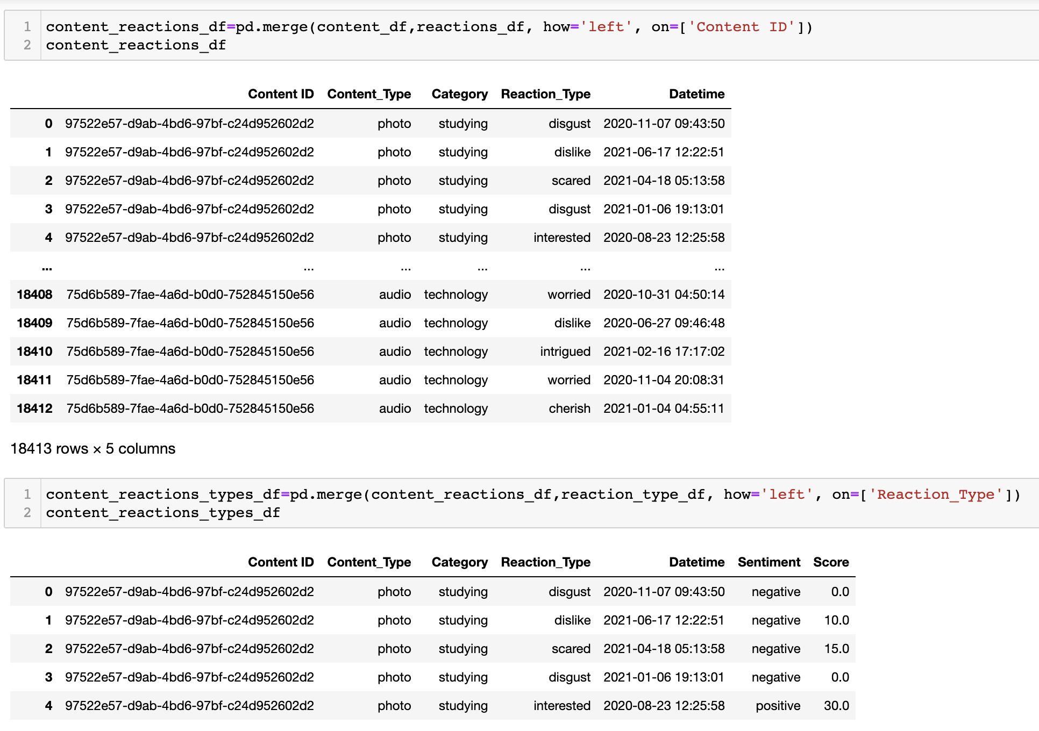
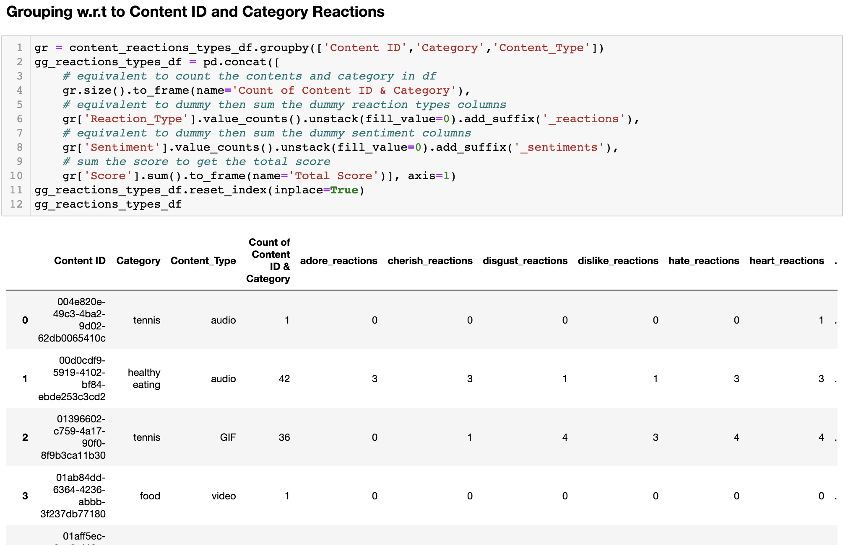
Merging of Data and Grouping
Merging Content and Reaction tables based on
Content I.D.
Merging the above table Content Reaction with
Reaction Type tables.
Grouping Categories and Content_Type and
Getting sum of sentiments and reactions.

Slide 10
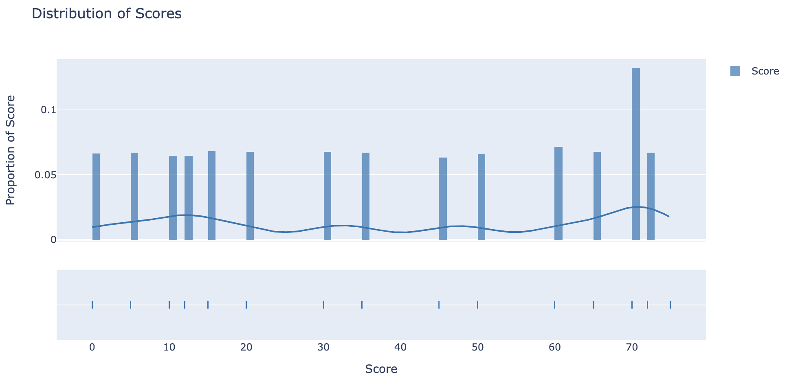
Data Visualization
We can the distribution of scores are more toward the positive side with 70 score having 12% of the scores to the dataset.
Many more such visualizations are available in the pdf file attached.

Slide 11
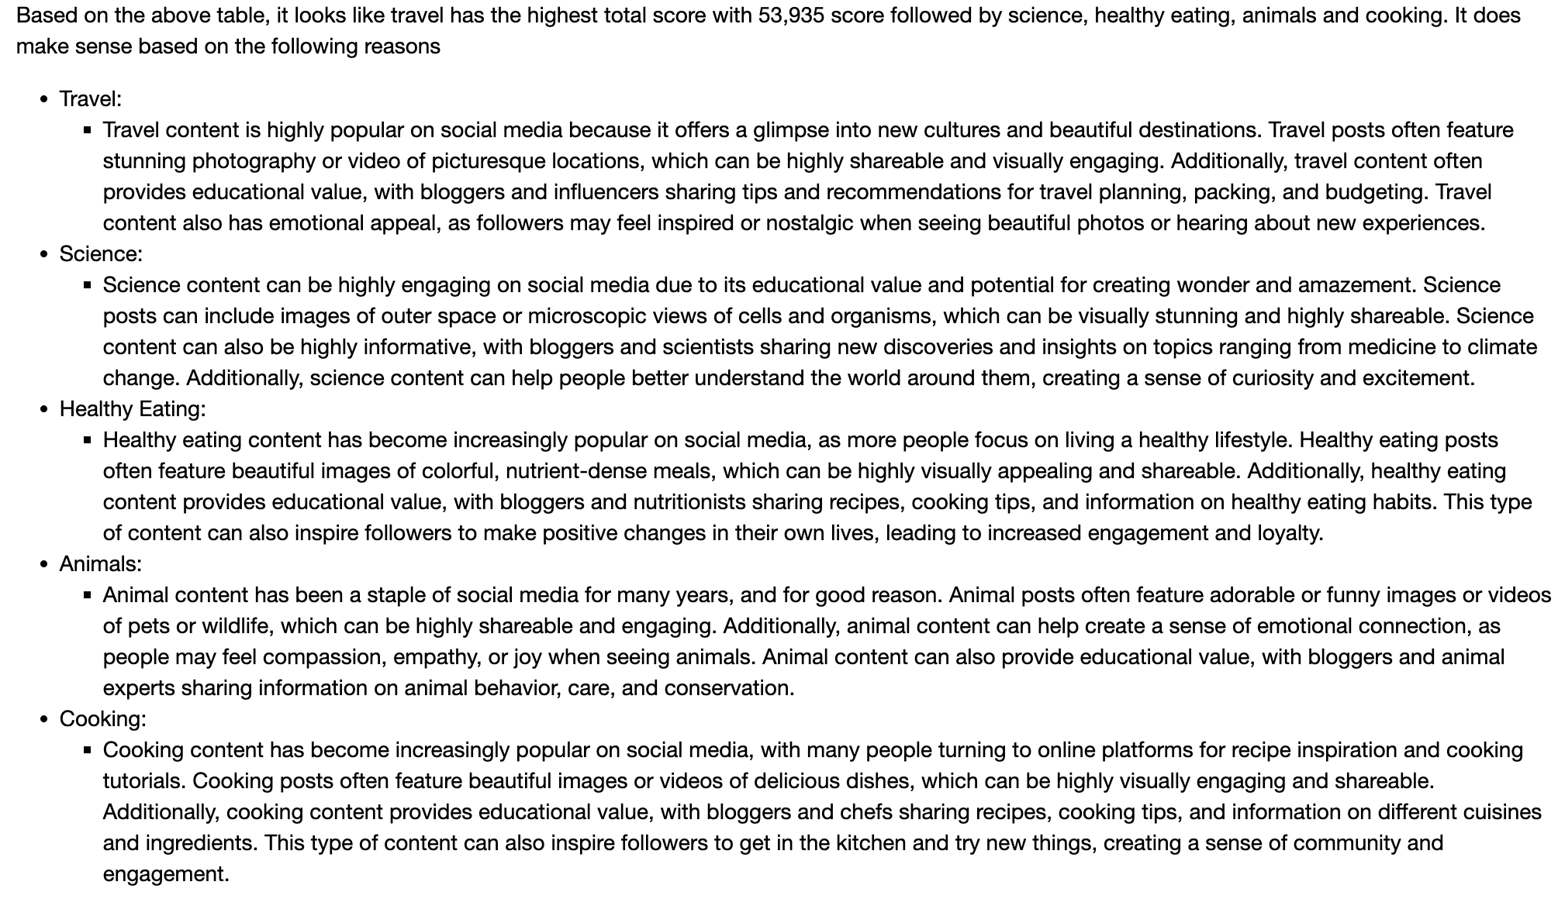
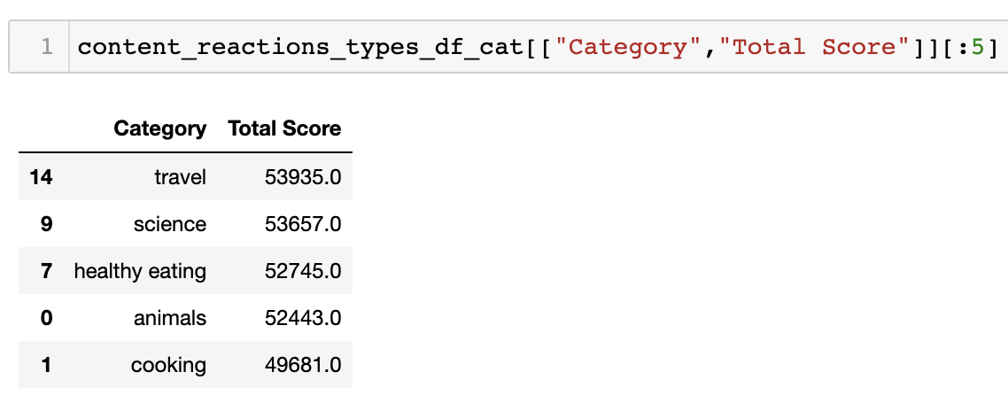
Data Analysis
Top 5 Categories

Slide 12
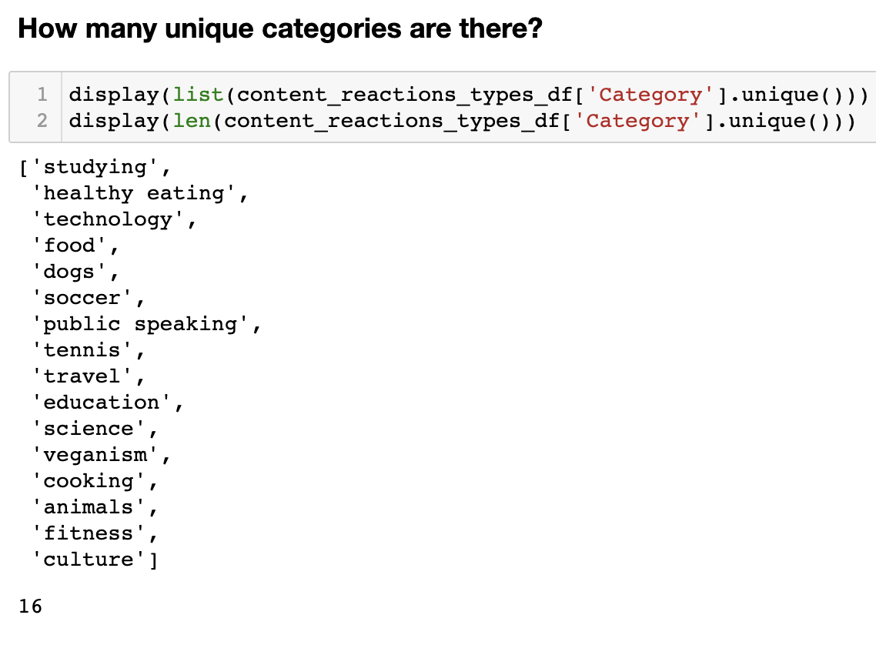
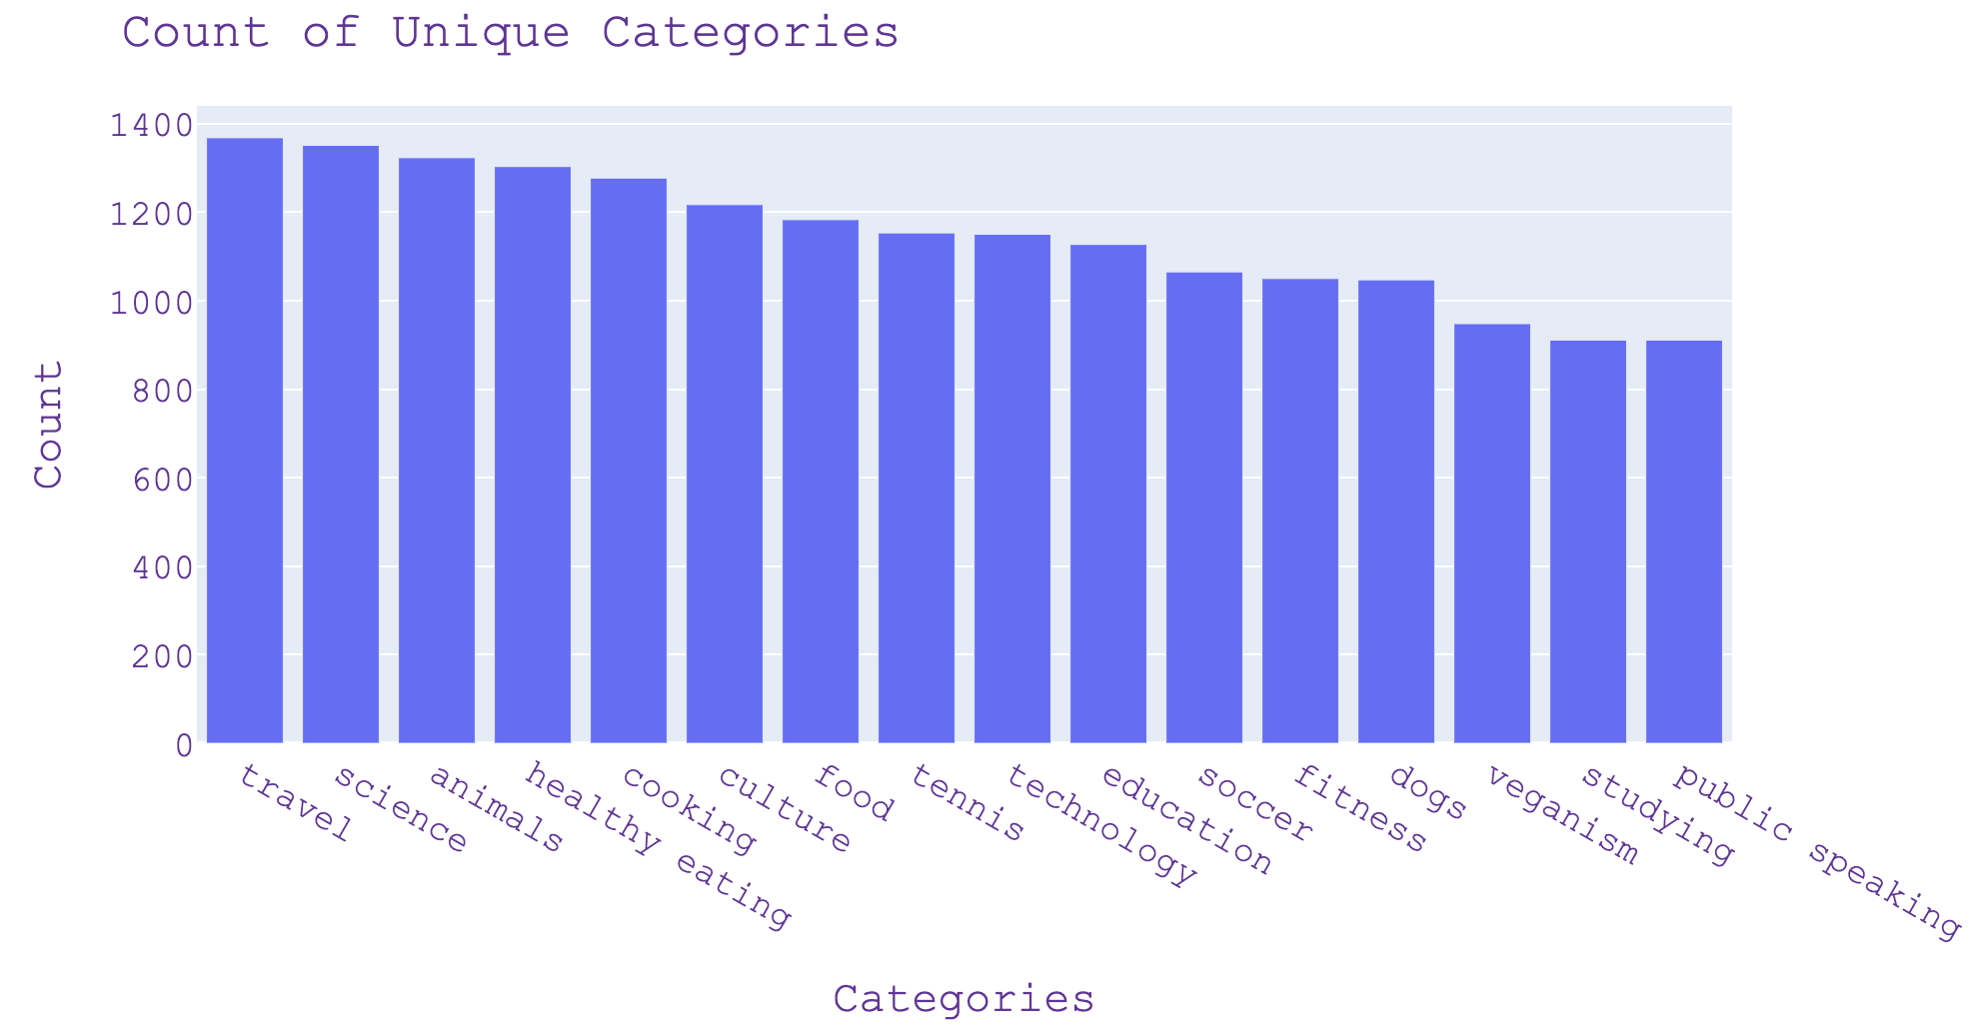
Charts
We analyzed the data and found that the dataset
consists of 16 unique categories. Interestingly, we
discovered that the two most reacted categories were Travel and Science.
This suggests that people on social media are particularly interested in content related to these topics.

Slide 13
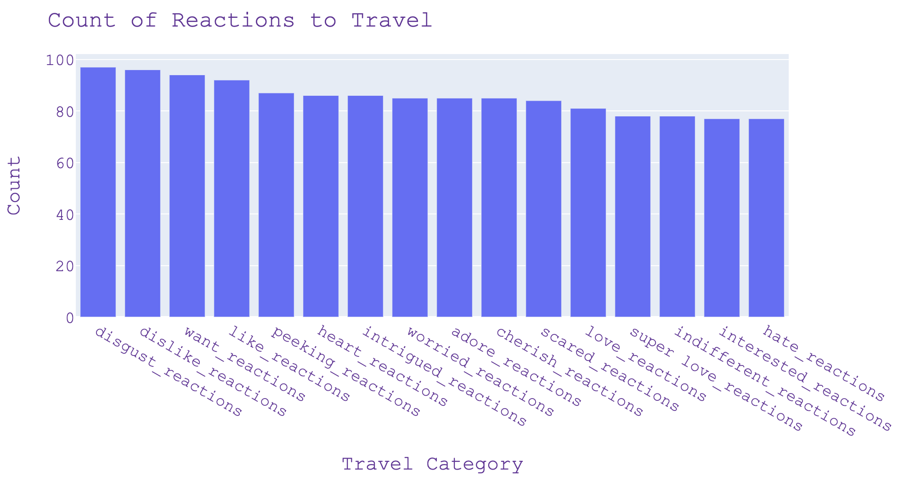
Charts
How many reactions are there to the most popular category?
When it comes to travel, social media users tend to have mixed reactions. While there are often expressions of excitement, wonder, and curiosity, there can also be negative reactions like disgust and dislike. Despite these mixed reactions, we also see a range of positive sentiment reactions like 'like' and 'heart' reactions, as well as more inquisitive sentiments like 'peeking' and 'intrigued' reactions.

Slide 14
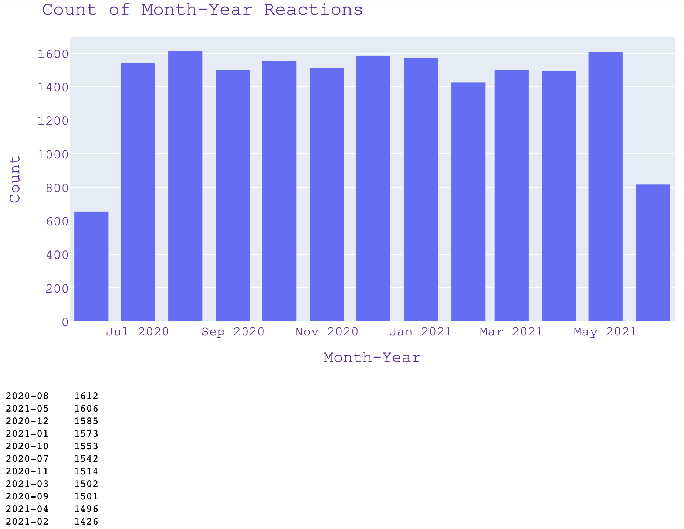
Charts
What was the month with the most posts?
Given that the dataset spans a two-year period
(2020 and 2021), we wanted to examine the results
both by month and by year. By doing so, we can
identify any patterns or trends that may emerge
over time. Our analysis reveals that the month with
the highest number of reactions was August 2020.
This could be due to a variety of factors, such as the
timing of major events or popular trends during
that month. Looking at the data across both years
can help us gain a better understanding of the overall
engagement and interest in the content
over time.

Slide 15

Insights
The insights based on the above table for a social media company with respect to the total score are as follows:
1. Travel is the highest-scoring category with a total score of 53935, indicating that it has a broad appeal and high engagement
on social media.
2. Science is the second highest-scoring category with a total score of 53657, which suggests that educational and informative
content is highly engaging on social media.
3. Healthy eating is the third highest-scoring category with a total score of 52745, indicating that content related to living a healthy
lifestyle has a significant following.
4. Animals are the fourth highest-scoring category with a total score of 52443, indicating that content featuring cute and funny
animals has a wide appeal on social media.
5. Cooking is the fifth highest-scoring category with a total score of 49681, indicating that content related to food and cooking is
still highly popular, although not as much as the other categories mentioned above.
These insights can help a social media company tailor its content strategy to focus on these high-scoring categories and create
engaging and shareable content that resonates with its audience.

Slide 16

To apply the top categories for a successful IPO, Social Buzz company can focus on creating valuable and inspiring content in the areas of travel, science, healthy eating, animals, and cooking. This can be achieved through creating engaging social media posts featuring stunning photography, informative and educational content, and emotional appeals. The company can also stress test their technology to identify and address any weak spots and communicate with previous IPO companies within their client base for reference stories. Finally, we can analyze sample data sets with visualizations and create full documentation of the process to guide Social Buzz through their IPO.
Summary

Slide 17

Thank you!
ANY QUESTIONS?

